Slide 1
Lecture 2: DART
SEB-312
Sidra Khatoon

Slide 2
Dart – Loops
A looping statement in Dart or any other programming language is used to repeat a particular set of commands until certain conditions are not completed. There are different ways to do so. They are:
for loop
while loop
do-while loop

Slide 3
for loop
For loop in Dart is similar to that in Java or any other language and also the flow of execution is the same as that in Java or any other language.
Syntax:
for(initialization; condition; text expression){
// Body of the loop
}

Slide 4
Control flow
Control flow goes as:
initialization
Condition
Body of loop
Test expression
The first is executed only once i.e in the beginning while the other three are executed until the condition turns out to be false.

Slide 5
Example
// Printing Hello World! 5 times
void main()
{
for (int i = 0; i < 5; i++) {
print(‘Hello World!');
}
}

Slide 6
while loop
The body of the loop will run until and unless the condition is true.
Expression:
while(condition){
text expression;
// Body of loop
}

Slide 7
Example
void main()
{
var a = 4;
int i = 1;
while (i <= a) {
print('Hello World!');
i++;
}
}

Slide 8
Do-while loop
The body of the loop will be executed first and then the condition is tested.
Syntax:
do{
text expression;
// Body of loop
}while(condition);

Slide 9
Example
void main()
{
var a = 4;
int i = 1;
do {
print('Hello World!');
i++;
} while (i <= a);
}

Slide 10
Dart – Functions
The function is a set of statements that take inputs, do some specific computation and produces output.
Functions are created when certain statements are repeatedly occurring in the program and a function is created to replace them.
Functions make it easy to divide the complex program into smaller sub-groups and increase the code reusability of the program.

Slide 11
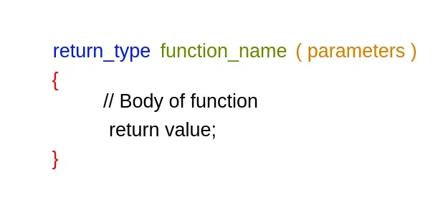
Defining the Function in Dart
Dart provides us with the facility of using functions in its program.
In the below syntax:
function_name: defines the name of the function.
return_type: defines the datatype in which output is going to come.
return value: defines the value to be returned from the function.

Slide 12

Defining the Function in Dart(cont.)
How to Call Functions in Dart?
In the above syntax:
function_name: defines the name of the function.
argument list: is the list of the parameters that the function requires.

Slide 13
Example
int add(int a, int b){
// Creating function
int result = a + b;
// returning value result
return result;
}
void main(){
// Calling the function
var output = add(10, 20);
// Printing output
print(output);
}

Slide 14
Dart – Classes And Objects
Dart is an object-oriented programming language, so it supports the concept of class, object … etc.
In Dart, we can define classes and objects of our own. We use the class keyword to do so. Dart supports object-oriented programming features like classes and interfaces.

Slide 15
Classes in Dart
Class is the blueprint of objects and class is the collection of data members and data function means which include these fields, getter and setter, and constructor and functions.
Declaring class in Dart
class class_name {
// Body of class
}

Slide 16
Classes in Dart(cont.)
In the above syntax:
Class is the keyword used to initialize the class.
class_name is the name of the class.
The body of the class consists of fields, constructors, getter and setter methods, etc.
The body of Constructor includes three things: Class Fields, Class Methods, and Constructors.

Slide 17
1: Class Fields in Dart
Classes Fields are the variables which data for the objects. Let us check with an Example:
class Student{
// Fields defining the
// Properties of Class
int? roll_no;
String? name;
}

Slide 18
2: Class Methods in Dart
Class Methods are the functions that provide behavior for an object. Let us check with a Example:
class Student{
// Fields defining the
// Properties of Class
int? roll_no;
String? name;
void print_name(){
print("Student Name: $name");
}
}

Slide 19
3: Constructors in Dart
A Constructor is a block of code that initializes the state and values during object creation. Constructor is name same as the class name and doesn’t return any value.
Syntax:
class_name( [ parameters ] ){
// Constructor Body
}

